Slide 1
Object detection with CNN
Basics
CNN Architectures & Popular Models
CNN Application Models
CNN’s Tensorflow API
Training CNN’s with TensorFlow 2.x

Slide 2
Basics
Image Video & Filter, Neuron-Layer-Neural Network, Spatial & Temporal data, Convolution Neural Nets, Selective search

Slide 3
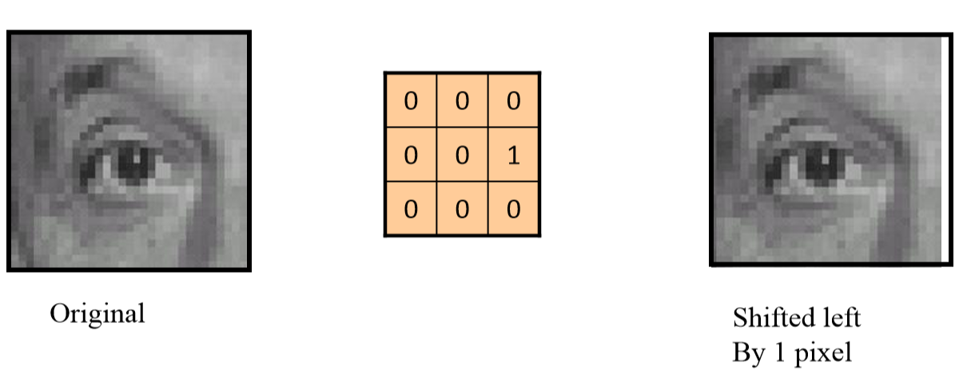
Images, Videos and Filter
Image is stored as numeric array with pixel values as RGB color
Video is continuous shot of images
(24 images/second)
Filter is a mathematical operation that is applied on image
Filter is a matrix which when applied(multiplied, added, subtracted) on image(input) highlights certain easy features like color, edge from which we can derive complex features like shape and texture
Notes:
https://cs.nyu.edu/~fergus/teaching/vision_2012/

Slide 4
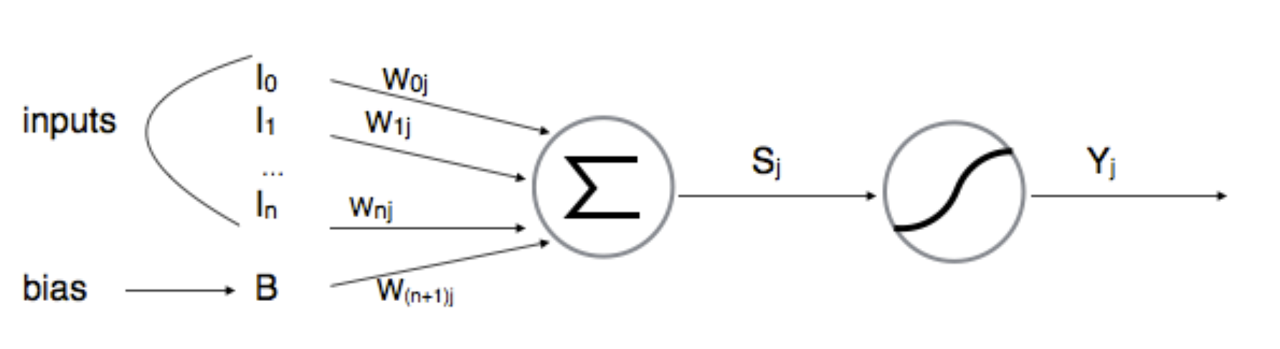
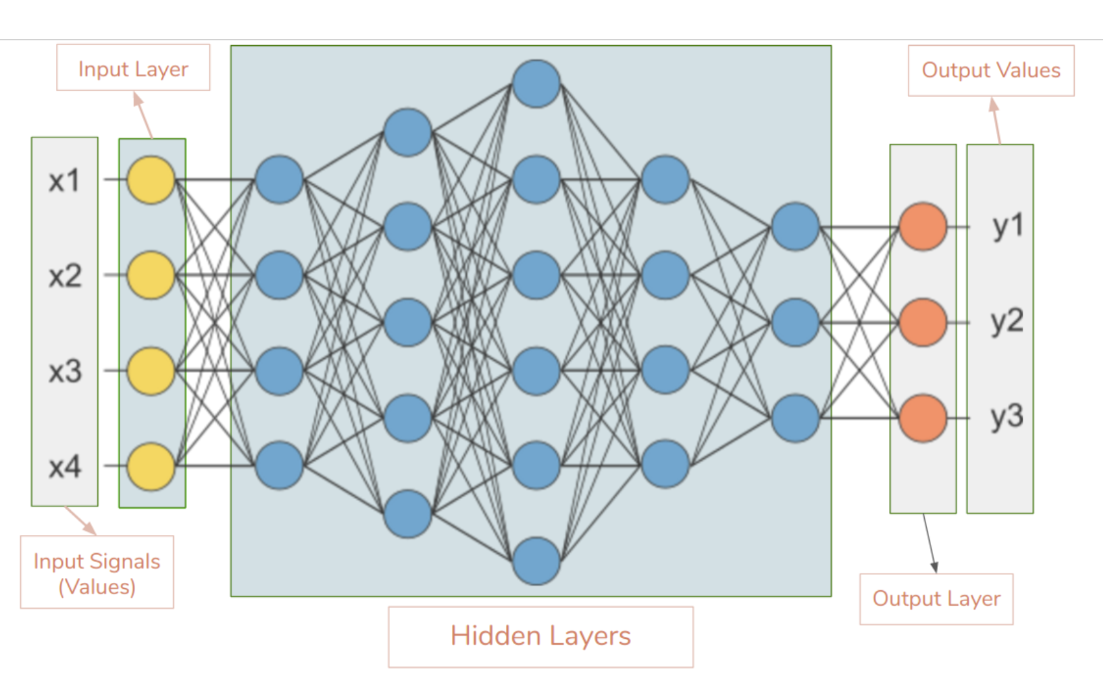
Neural Network
*w11
2
*w21
*w11
Neuron1
*w31
*w21
Neuron2
Layer is group of neurons performing an operation.
In this scenario there are 49 neurons required to complete shift image
*w31
*w12
Neuron– The core performing units of NN
1
*w22
*w12
*w22
Weights – how important is input in determining output
Bias – numeric correction that’s added
Activation function. It takes inputs applies mathematical operation as below and shoots 0 or 1 (Yi). (Remember computer only operates in Binary)It adds a non-linear property to neural network. Without the activation functions, the neural network could perform only linear mappings from inputs x to the outputs y
*w32
*w32
*w31
*
*w32
*w31
*w32
*
*w33
*w33
*
Activation function
Reason for having many layers
3
While Painting, we follow certain steps - Sketch , sharpen , add colors
Computer learns by doing opposite in reverse order
Black and white > blur to get the rough sketch
4

Slide 5
Spatial and Temporal Data
Temporal Data
Spatial Data
time
You know that there are two rectangles in this image only by comparing with neighbouring pixels
Multiple shots of images taken over time. We want to compare different images
Application – Object Tracking, computing speed of cars
No sense in making comparison across images. But, it is very important to make comparison within image
Application – Object detection
Notes:
https://cs.nyu.edu/~fergus/teaching/vision_2012/

Slide 6
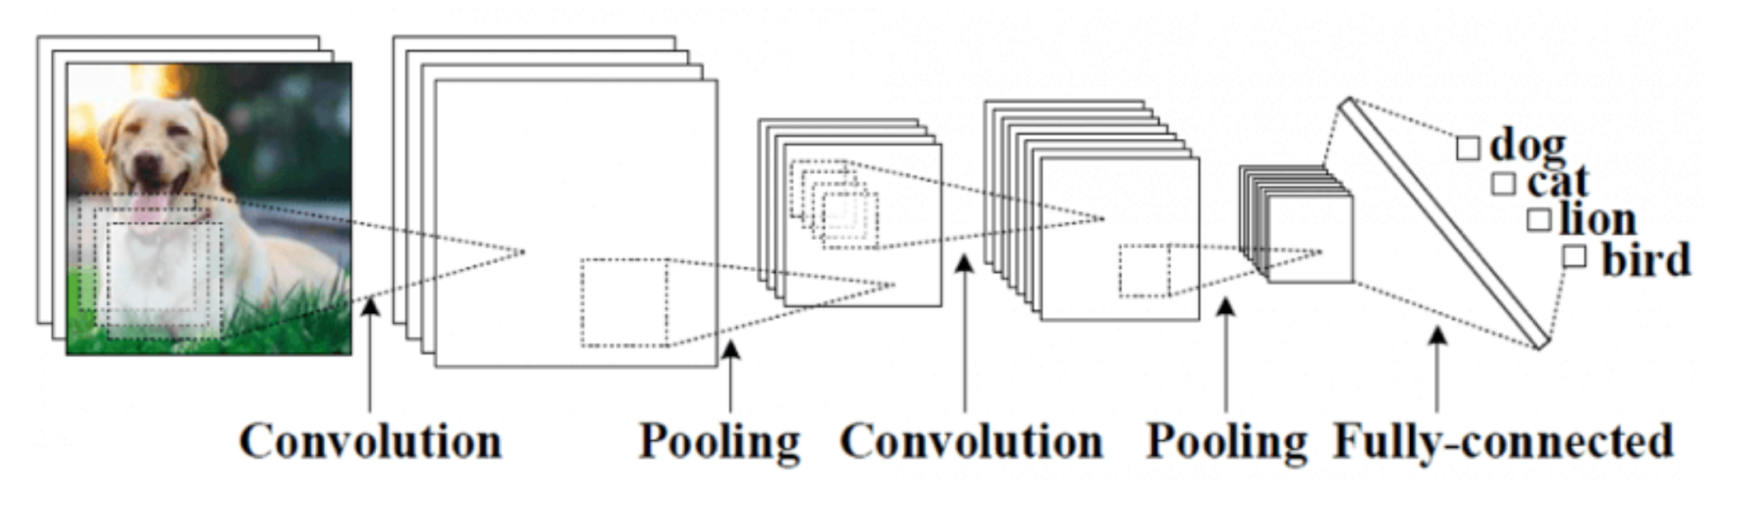
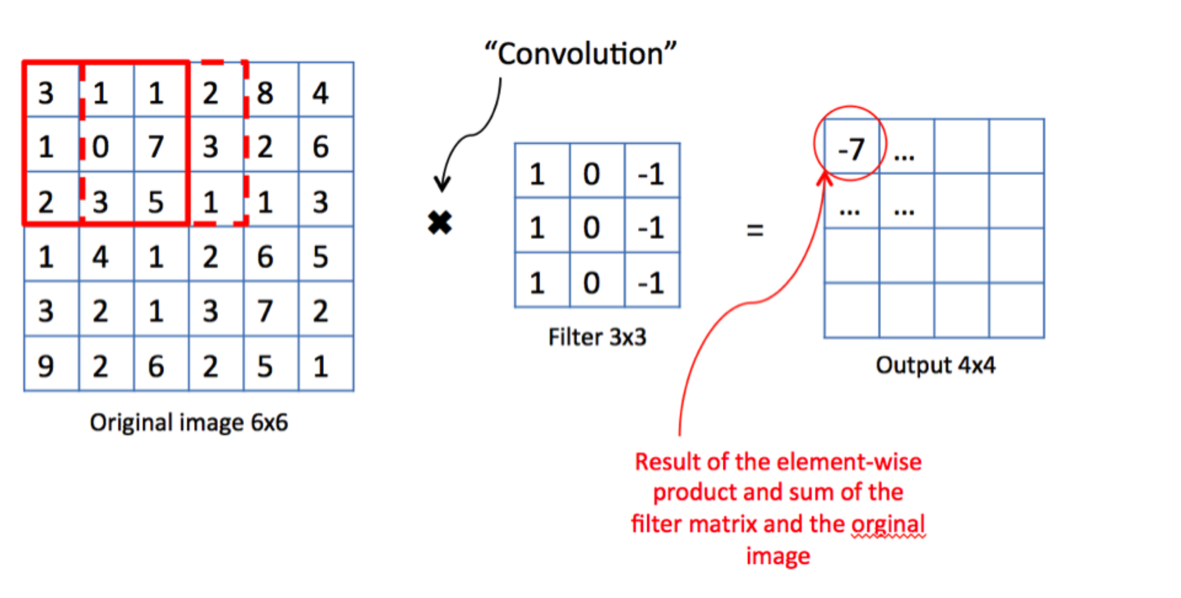
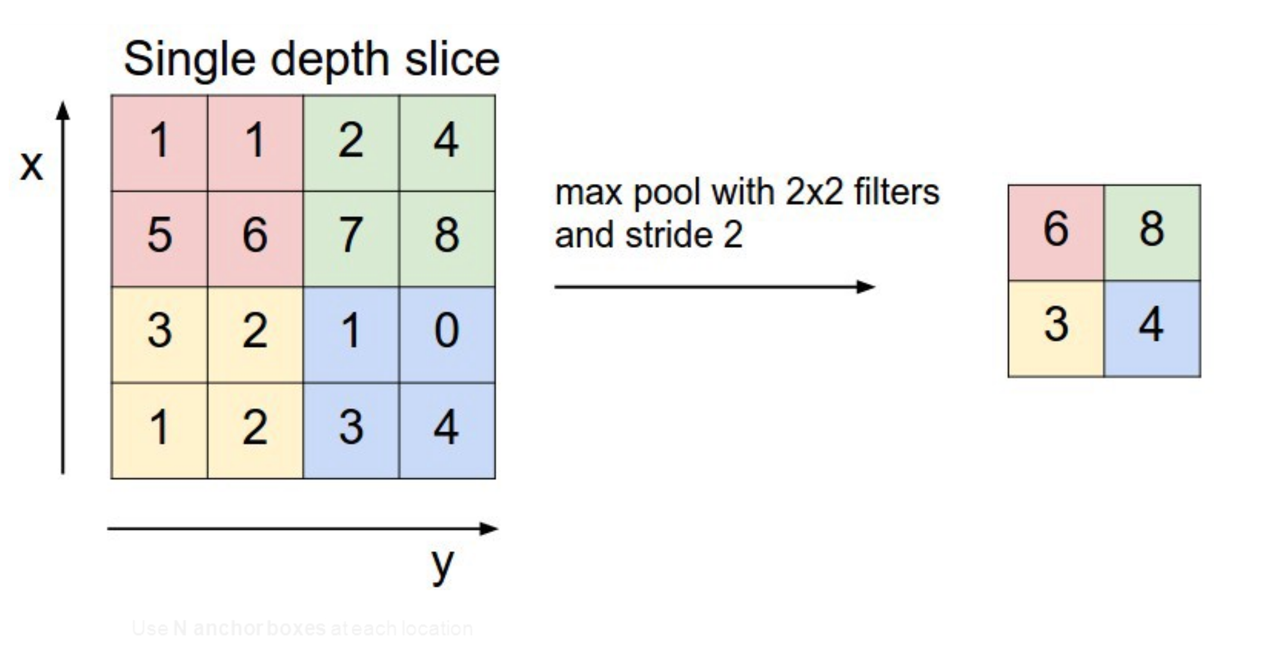
Convolution Neural nets
Convolution Layer – Filter operation
Pooling Layer – This picks selecteds features in the features map by eliminating pixels with low values
1
3
Fully connected Layer – classification
Every input is connected to every neuron
Convolution Neural Nets are widely used in Object detection any thing which is spatial. It is not suitable for temporal data
2
Notes:
Steps --- outline --- sharpen – color
Opencv --- black while , blur,

Slide 7
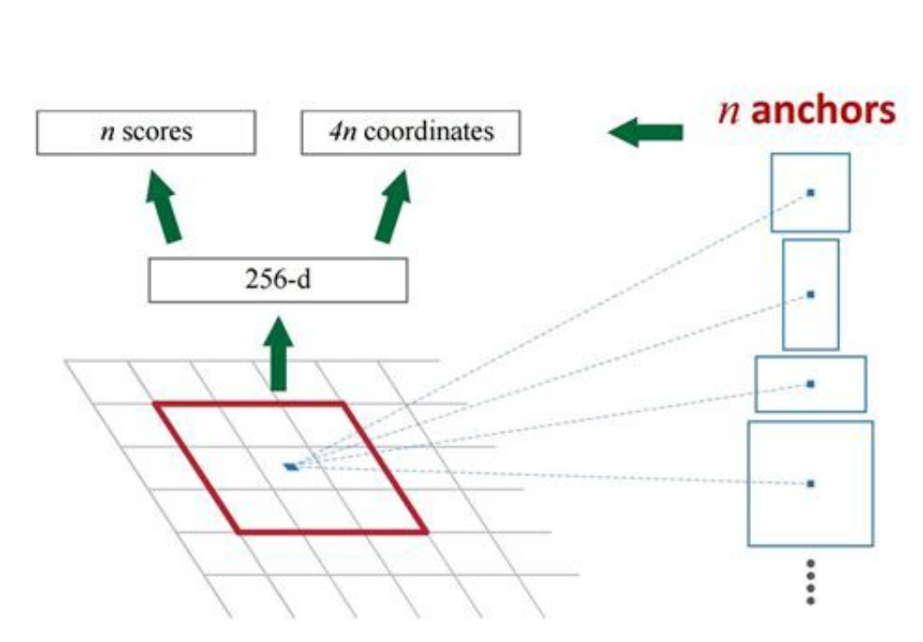
Region Proposel Network (RPN)
Use N anchorboxes at each location
Anchors are translation invariant use the same ones at every location
Regression gives offsets from anchor boxes
Classification gives the probability that each anchor shows and object
Selective search
Notes:
https://cs.nyu.edu/~fergus/teaching/vision_2012/

Slide 8
CNN Architectures
Here
RCNN * Fast RCNN * Faster R-CNN * R-FCN * SSD * Comparison

Slide 9
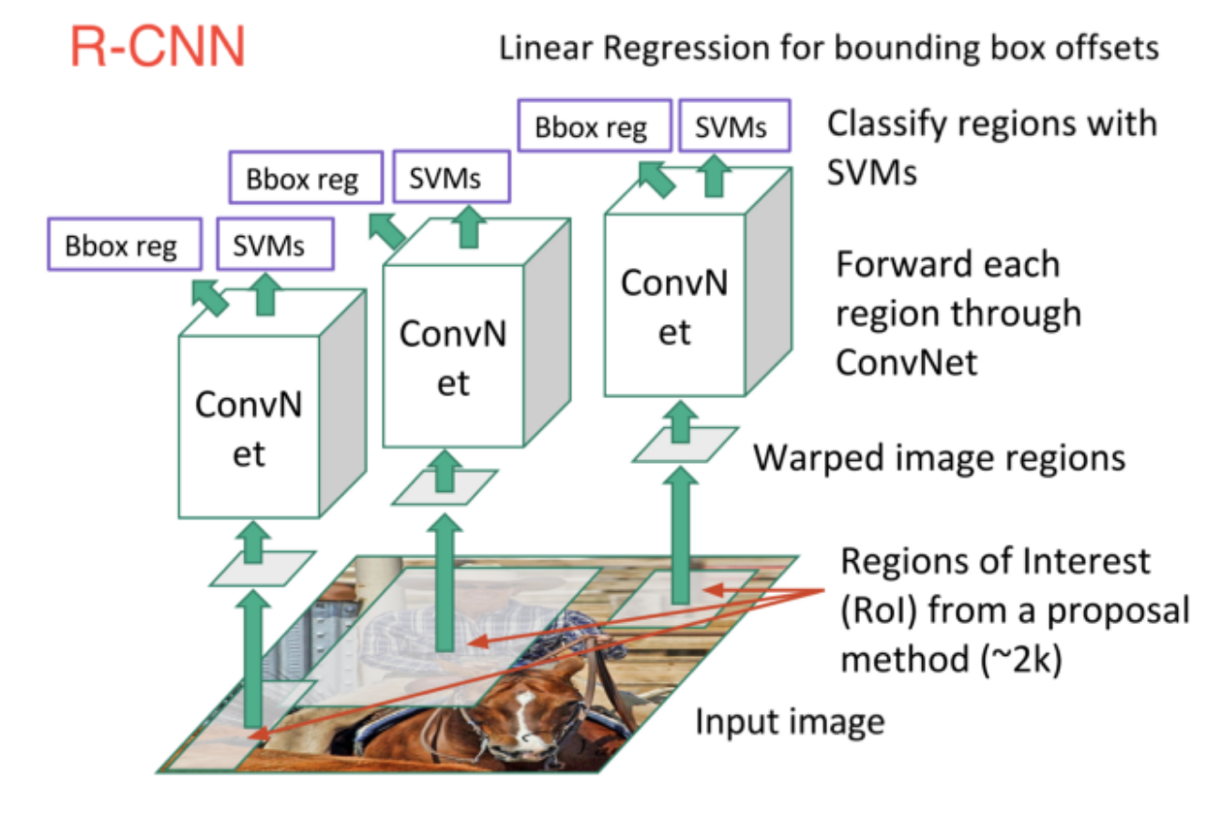
R-CNN
Notes:
https://cs.nyu.edu/~fergus/teaching/vision_2012/

Slide 10
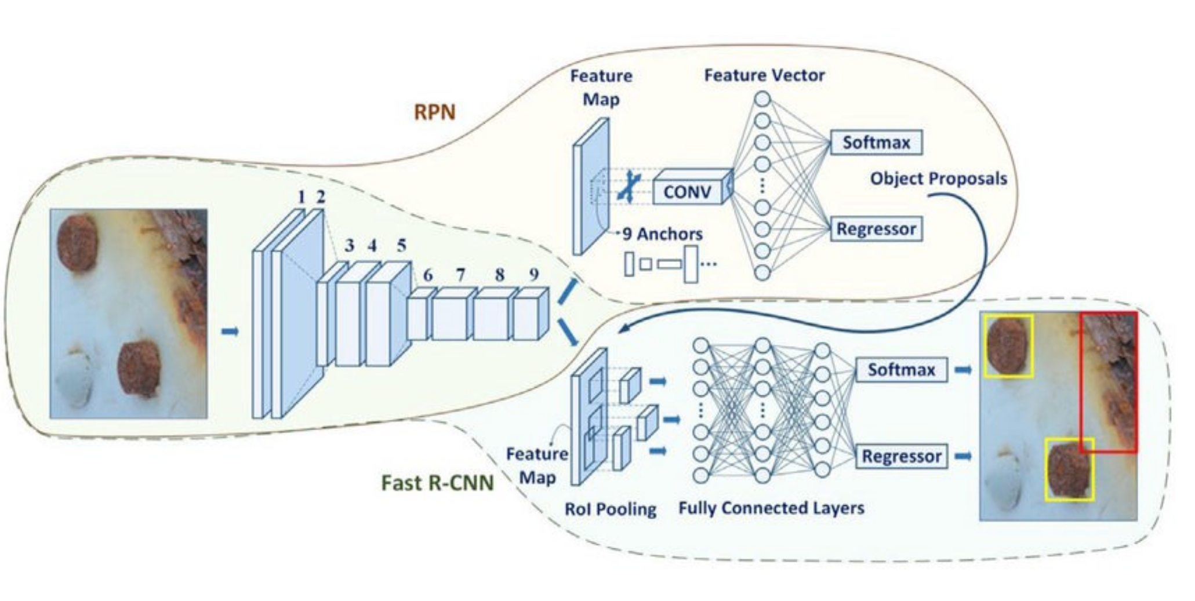
Faster RCNN

Slide 11
CNN Application models
Darknet, Recent, Inception Resnet

Slide 12
CNN’s Tensorflow API

Slide 13
Tf.keras.application
deep learning models that are made available alongside pre-trained weights. These models can be used for prediction, feature extraction, and fine-tuning.

Slide 14
Training CNN’s with tensorflow 2.x

Slide 15
Including fully-connected layer on top of network

